Slide 1
Reinforcement Learning with Games

Slide 2
Overview
My final year project is the investigation of the use of Reinforcement learning algorithms in games.

Slide 3
What Is Reinforcement Learning
Reinforcement learning is the evaluation of a state using a rewards system.
What does this mean?
Through training using reinforcement learning, the system will be able to achieve a win or goal and do so in an efficient manner.
The Reward system is used to give a weight to these states.

Slide 4
Reinforcement learning 2
Example:
Game: Draughts/Checkers
Rewards:
  + Take opponents piece or being kinged
  - Opponent takes your piece

Slide 5
Temporal difference learning
Temporal difference evaluates a state by comparing the difference with its successive state.
The measure of these states periodically rather than all at once at the end, giving the system an easier compute time.

Slide 6
Q-Learning
Q-learning is an off policy version of

Slide 7
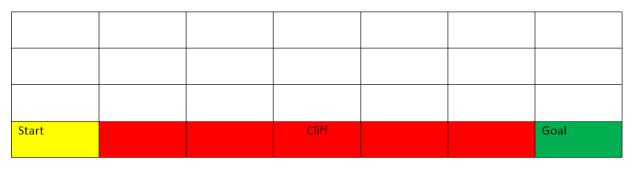
Temporal difference
Cliff walk example.

Slide 8
Reinforcement learning with Board Games
Why chose checkers over something like chess?
I chose checkers as it is a much rule set to chess which allows for a higher focus on reinforcement learning[1].
Checkers is still a complex game though with 10^20 different board positions.

